Slide 1


IDS 1721
Computing and Problem Solving for STEM Chapter 05
Abstraction
Lesson 01

Slide 2
Course Learning Outcomes
Describe the fundamentals of the computing environment for problem-solving using variables, arrays, and functions.
Interpret computing concepts and distinguish between environment provided functions and user-defined functions.
Utilize programming concepts such as iteration processes, conditional statements, and logical constructs to design solutions to diverse problems.
Implement pseudo code into working code using structured programming principles.
Formulate and refine algorithms to solve problems in STEM Fields
Communicate and comment on code and solutions to multi-step problems through careful, organized, and well-annotated work.

Slide 3
Chapter 05: Overview
Learn the concepts for:
Functions, specification, implementation, local variables, parameters, output parameters, call-by-value, efficiency, level of abstraction, subfunctions, in-line code
Learn language features:
Function: A named set of statements stored in an m-file. A function may have any number of input parameters and output parameters.
Subfunction: A function m-file may contain more than one function. The top function is the main function and is accessible by scripts and other functions

Slide 4
Chapter 05: Videos
Video 14. User-Defined Function
How to define and call your own functions
Video 15. Executing a Function
How a function executes and what happens in memory

Slide 5
Built-In Functions
The built-in sin function is so handy that we don’t know how it works; it just works, so it’s like a “black box”.
All we need to know is that sin expects a real input value and that it outputs the sine of that value interpreted in radians.
The code is shorter since it uses a built-in function rather than creating the code for it.
The resulting program is shorter and harmonizes better with our mathematical thinking.
Being able to write effective functions is central to the problem-solving process.
It supports the top-down methodology, enabling us to hide lower-level details while we address higher-level design issues.

Slide 6
Built-In Functions
We start by developing a function for computing square roots that is based on a rectangle averaging process. The fact that sqrt is a built-in function gives us a standard against which we can measure the quality of our implementation.
Next, we consider the problem of computing the perimeter of an ellipse. Two reasonable function-writing strategies emerge, providing an opportunity to discuss the tension that sometimes exists between clarity and efﬁciency.
The challenge of designing the 13-star Colonial ﬂag dramatizes the power of the top-down methodology and illustrates how function writing can crystallize our thinking during the design process.

Slide 7
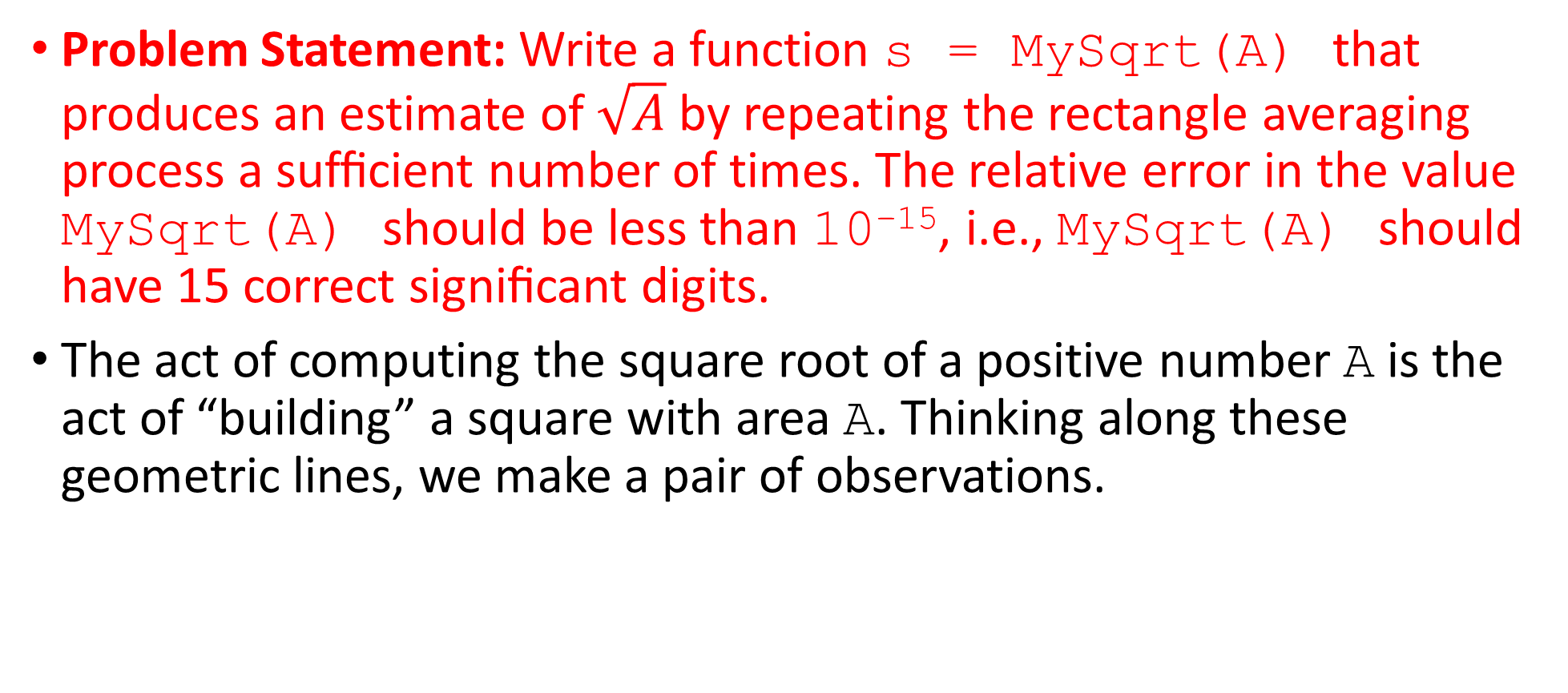
Problem 1: Reshaping Rectangles
Problem Statement: Write a function s = MySqrt(A) that produces an estimate of $\sqrt{A}$ by repeating the rectangle averaging process a sufﬁcient number of times. The relative error in the value MySqrt(A) should be less than 10⁻¹⁵, i.e., MySqrt(A) should have 15 correct signiﬁcant digits.
The act of computing the square root of a positive number A is the act of “building” a square with area A. Thinking along these geometric lines, we make a pair of observations.

Slide 8
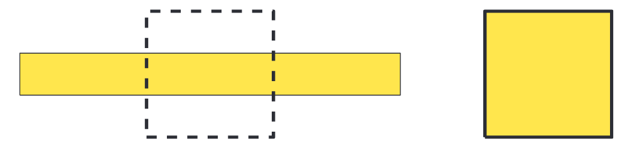
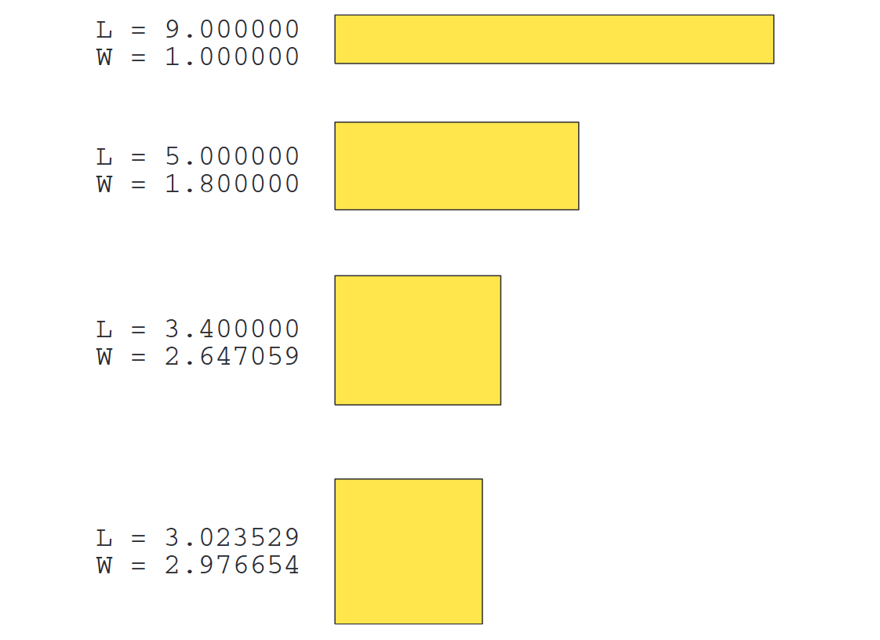
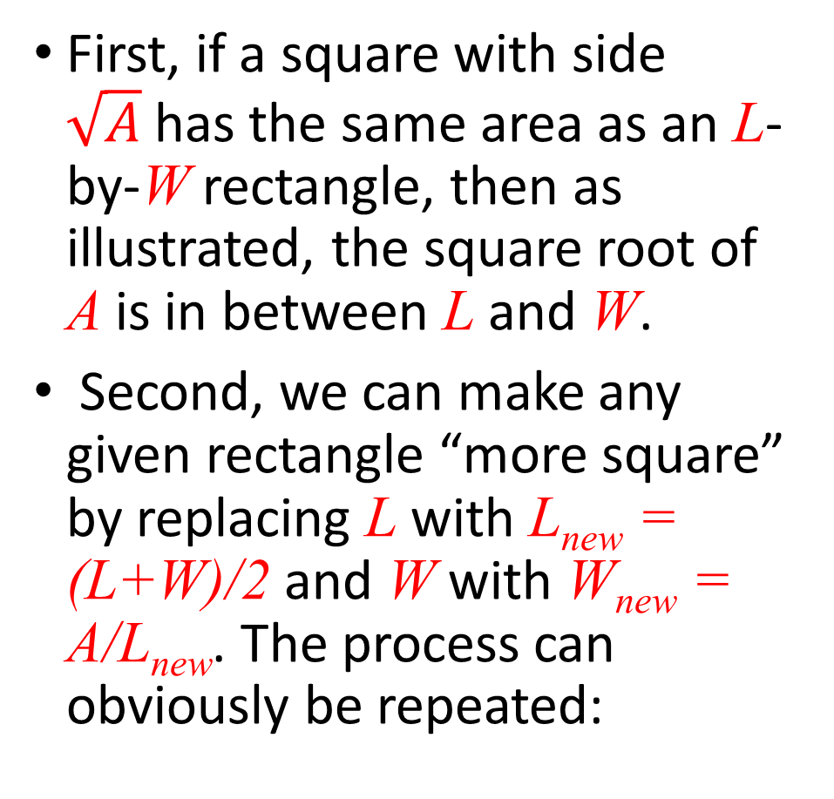
Problem 1: Reshaping Rectangles
First, if a square with side $\sqrt{A}$has the same area as an L-by-W rectangle, then as illustrated, the square root of A is in between L and W.
Second, we can make any given rectangle “more square” by replacing L with L_{new} = (L+W)/2 and W with W_{new} = A/L_{new}. The process can obviously be repeated:

Slide 9
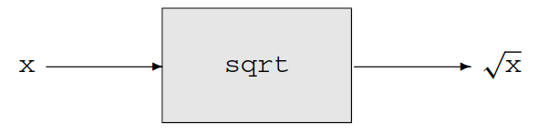
Program Development
Before we develop MySqrt, let us think a little bit about the MATLAB built-in function sqrt. It can be visualized as a “black box” with an input and an output:
A nonnegative number arrives at the “front door,” mysterious things happen, and out pops the square root.
As users of sqrt, we do not have to worry about the mysterious inner workings of sqrt, i.e., it can be treated as a black box.
However, we do have to “read the manual” about sqrt so that we can use it properly. The MATLAB help facility is designed for this purpose.

Slide 10
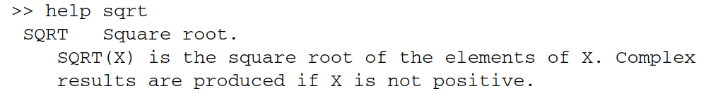
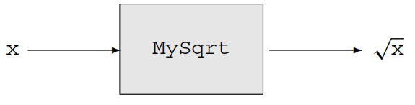
Program Development
From the command window we ﬁnd
The language here is a little confusing because sqrt can accept a vector, a feature that we ignore for now. But the message is important. Writing a description on how to use a function is as critical as designing the function itself.
Our plan is to write our own version of sqrt and call it MySqrt. To the user, it will look the same:

Slide 11
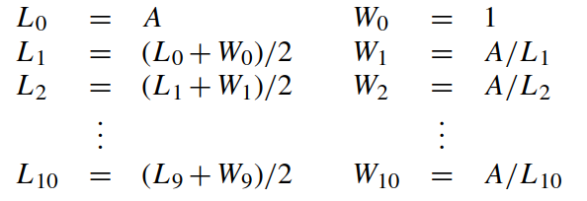
Program Development
The inner workings of MySqrt become our responsibility and that is where we start. After code is developed that implements the rectangle averaging process outlined above, we “package it up” as a function that can then be used just like sqrt.
Deﬁne L_{i} and W_{i} to be the length and width of the rectangle after i averagings. Let us examine the quality of the approximation after ten iterations. The improvement sequence

Slide 12
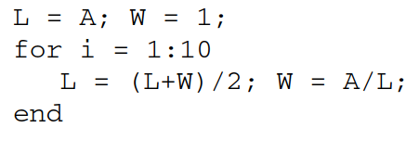
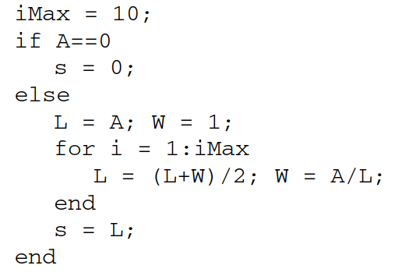
Program Development
It can be coded into a short loop
We are assuming that A is initialized
What about if A =0?
Ten iterations might not be enough, let’s use a new variableiMax to adjust the limit
s is the length of the final rectangle

Slide 13
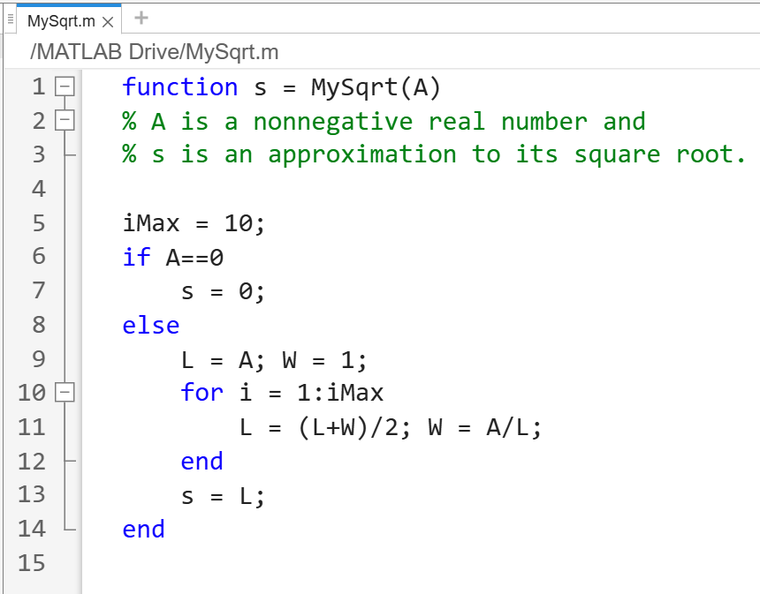
Program Development
Next in the derivation of MySqrt comes the packaging part. It involves prefacing the above implementation with a function header and placing everything in an m-ﬁle, MySqrt.m as shown. The various parts that make up a function are indicated

Slide 14
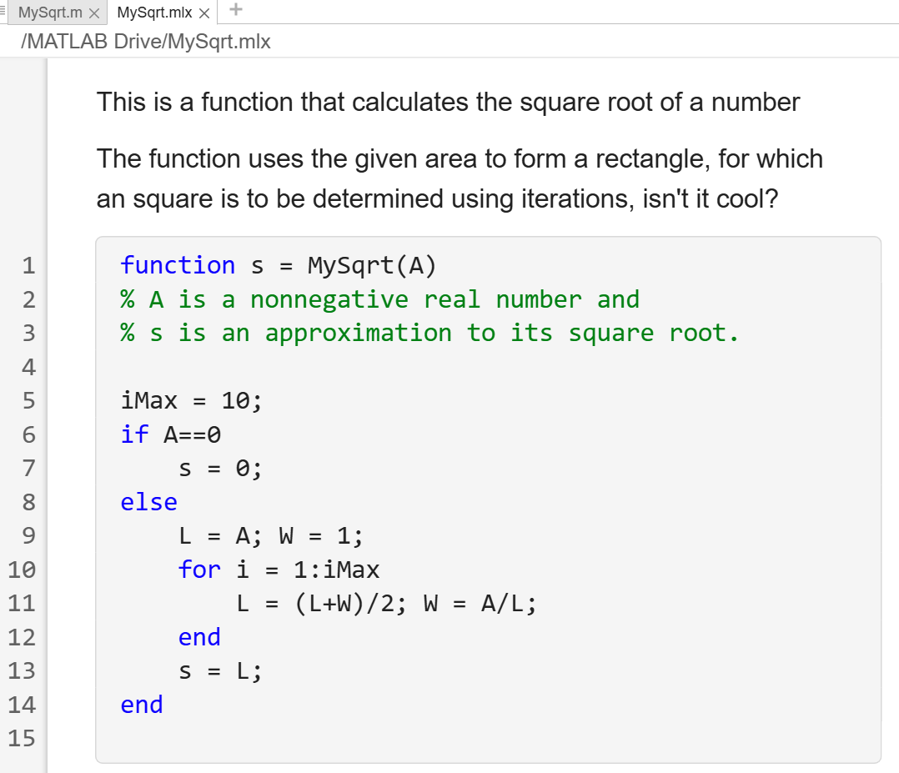
Program Development
Next in the derivation of MySqrt comes the packaging part. It involves prefacing the above implementation with a function header and placing everything in an m-ﬁle, MySqrt.m as shown. The various parts that make up a function are indicated

Slide 15
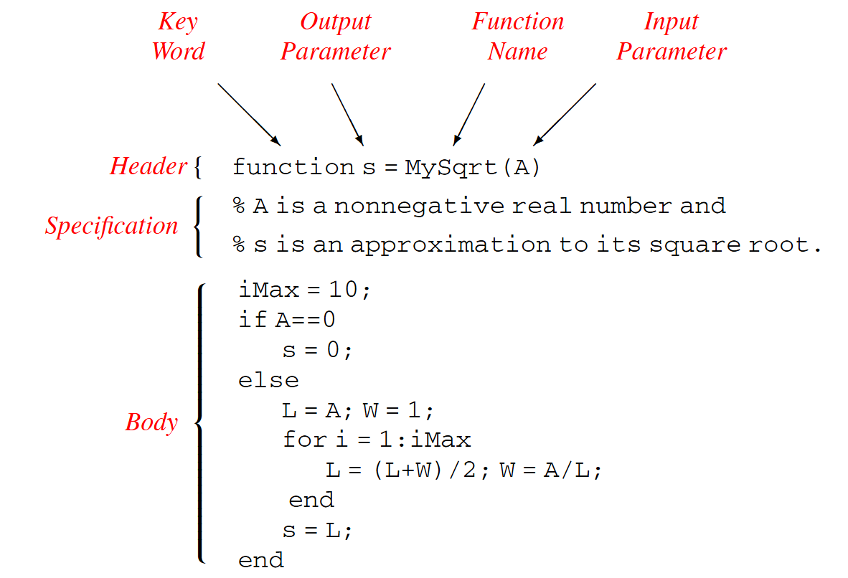
Program Development
The function header begins with the keyword function.
Every function must have a name and the naming conventions are the same as for variables. Admissible characters include letters (upper- or lowercase), digits, and the underscore, and the ﬁrst character must be a letter.

Slide 16
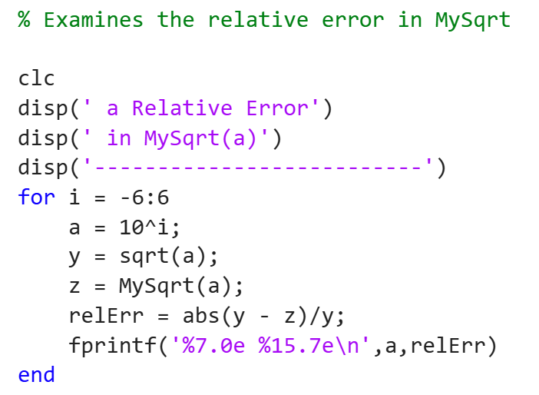
Program Development
To understand how functions work, we consider the following script which compares MySqrt(a) and sqrt(a) over a range of input values.
The relative error is the “percent error”—the absolute error divided by the “true” value.

Slide 17
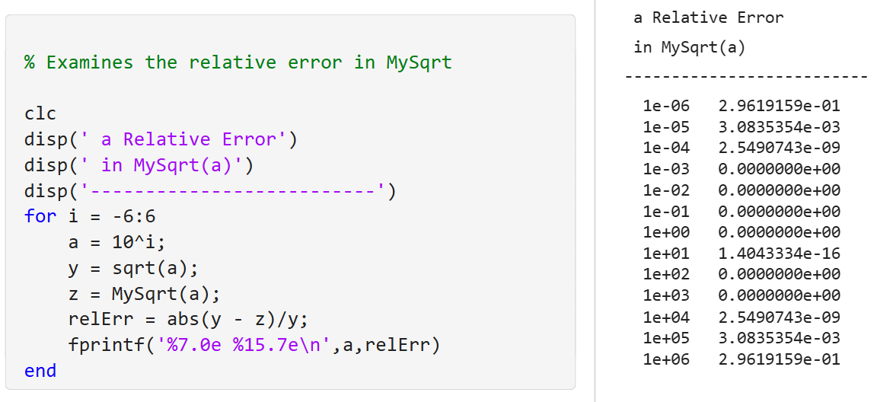
Houston, we have a problem…
Accuracy is not that good, yet, let’s explore why
Increasing error
No error
Increasing error

Slide 18
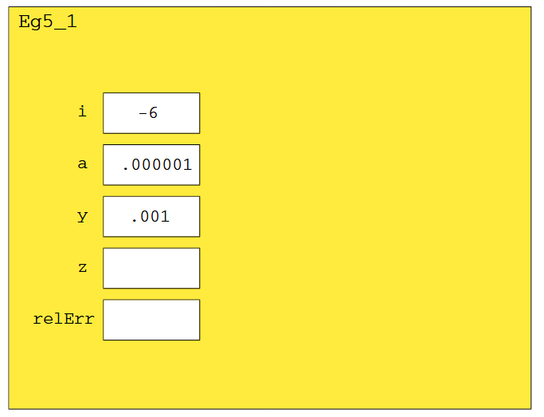
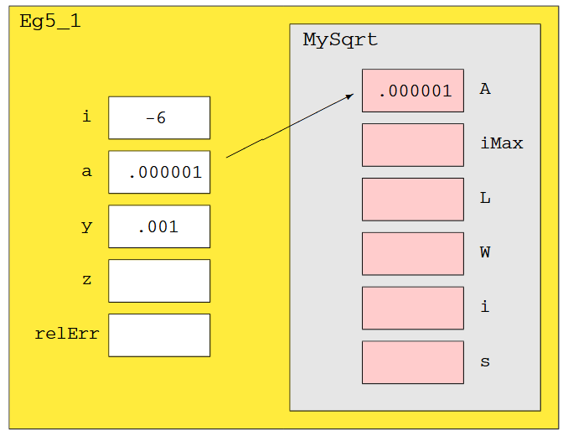
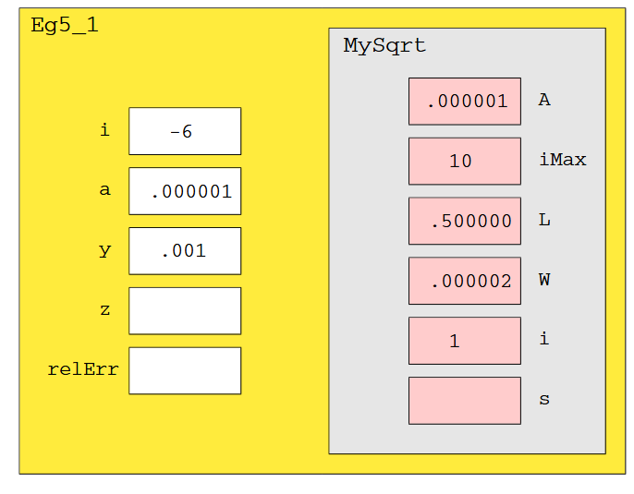
Program Development
Step 1
Command window is cleared
Table headings are shown
For-loop starts: i=-6 & a=10^{i}
sqrt = 0.001 and assigned to y
Step 2
z = MySqrt(a) calls the function
MySqrt function starts
The a value is passed as A
Step 3
MySqrt function runs
Values are initialized
1st run of the for-loop

Slide 19
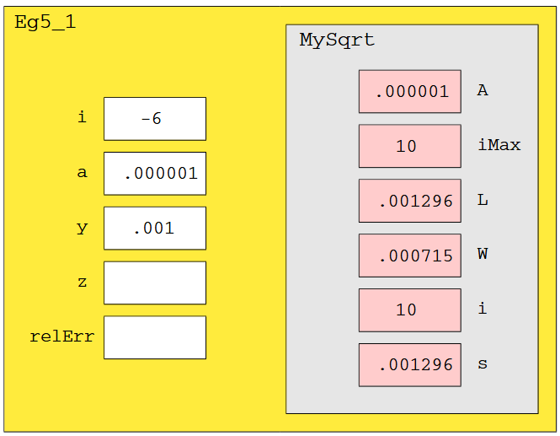
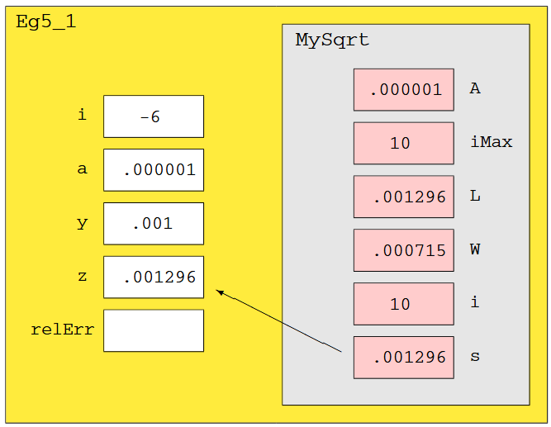
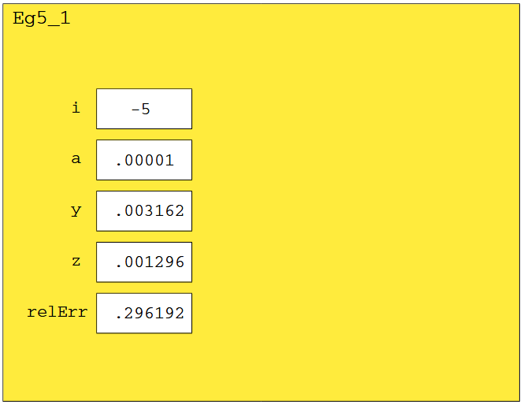
Program Development
Step 4
The MySqrt function finishes and the final value of L is assigned to s
L and w are not identical!
Step 5
The s-value, the output, is passed back to the script
z = MySqrt(a) is complete
The function call is over
Step 6
Content from MySqrt disappears
The main script resumes
Error is calculated and printed
Second run starts at i=-5

Slide 20
Program Development
The main script calls MySqrt thirteen times, meaning that control passes back and forth thirteen times. The communication takes place only through the input and output parameters. The computations inside MySqrt are “insulated” from the calling script.
What about accuracy? One solution is to increase the value of iMax, but there are two problems associated with a large iMax.
The ﬁrst concerns efﬁciency. Many more iterations than necessary will be carried out for “nice” input values that do not require a huge number of rectangle averagings.
Second, no matter how large we make iMax, there will always be a range of input values upon which we will get poor results. The way out of this situation is to use a while-loop.

Slide 21
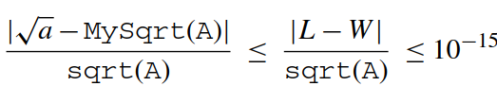
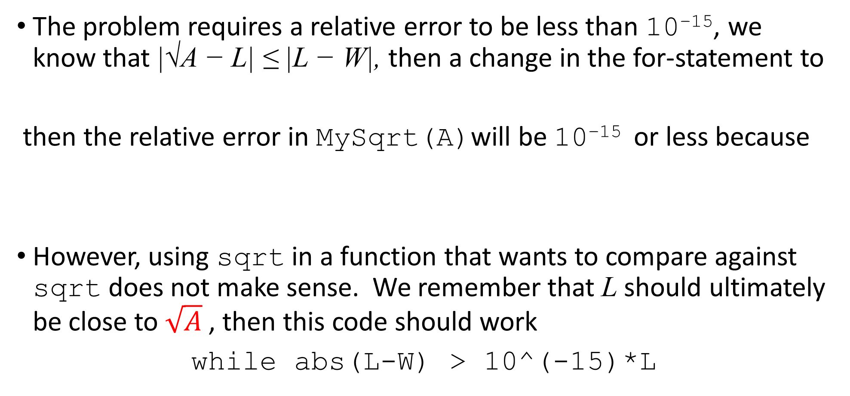
Program Development
The problem requires a relative error to be less than 10⁻¹⁵, we know that |√A − L| ≤ |L − W|, then a change in the for-statement to
then the relative error in MySqrt(A)will be 10⁻¹⁵ or less because
However, using sqrt in a function that wants to compare against sqrt does not make sense. We remember that L should ultimately be close to $\sqrt{A}$, then this code should work
while abs(L-W) > 10^(-15)*L

Slide 22
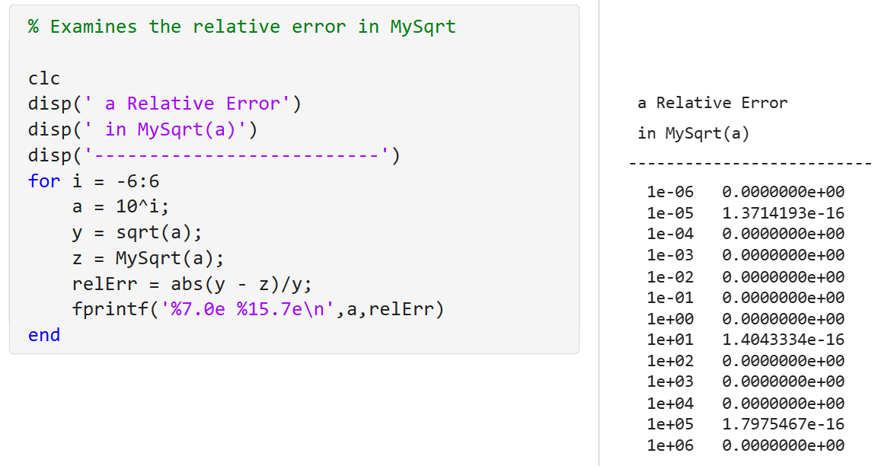
Program Development: Final Code
The new code is better!
The main code was unchanged
Only the function was edited

Slide 23
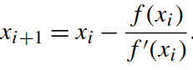
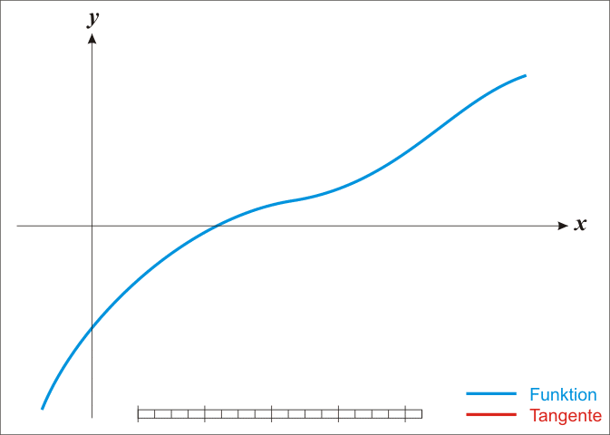
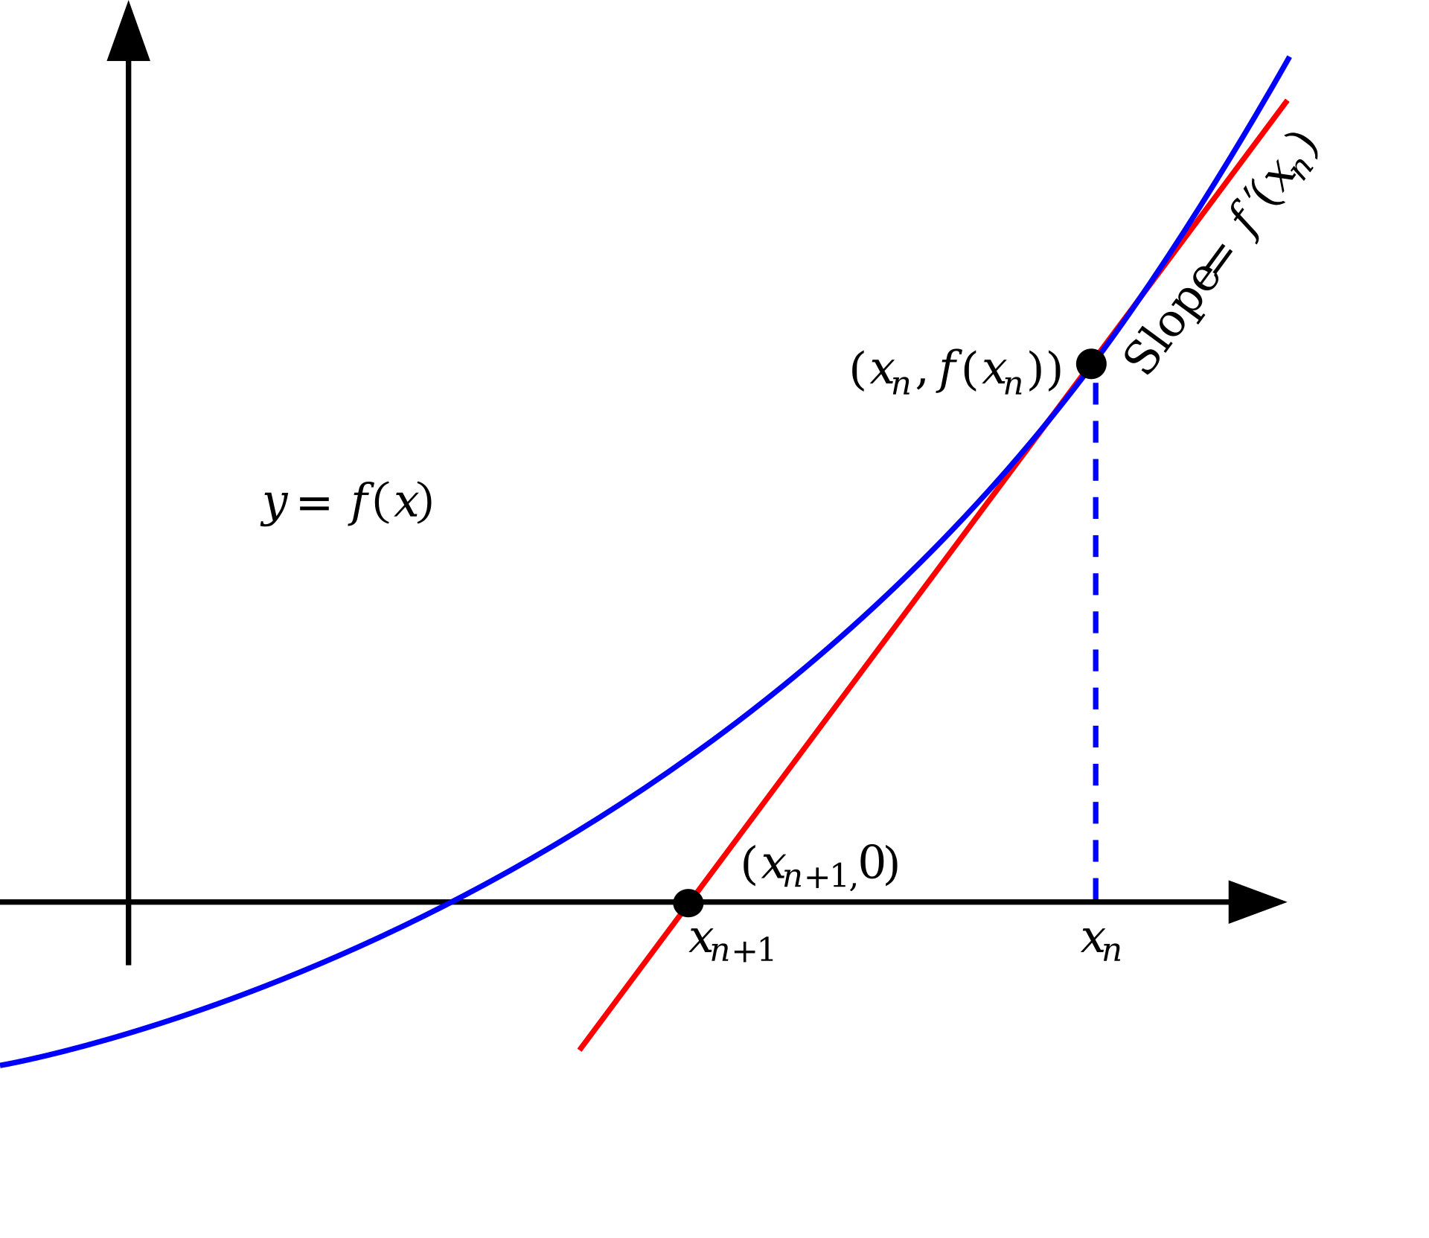
Talking Point: Who Needs Calculus?
Newton’s method for ﬁnding a zero of a function f is given by
Notes:
Newton’s method is an approximation method to find when the curve crosses the horizontal axis (y-axis = zero) by using an initial guess and subtracting f(x)/slope
The slope is rise/run=delta y/ delta x = dy/dx = f’(x), so delta x = delta y/slope = delta y/f’(x)
The final point is x-(delta x) = x – delta y/f’(x) = x – rise/slope
After a few runs, the solution can be found

Slide 24
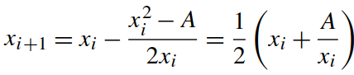
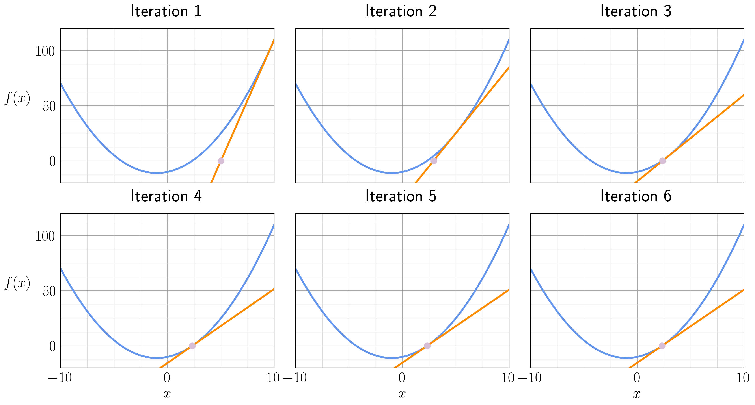
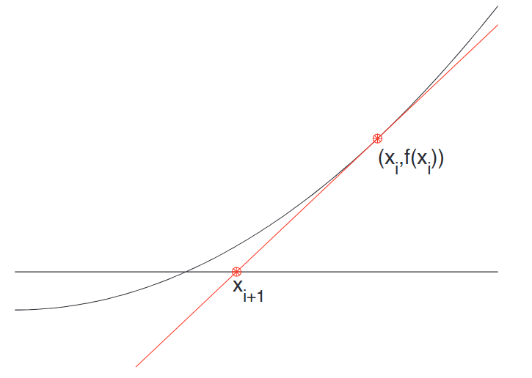
Talking Point: Who Needs Calculus?
Noting that the square root of A is a zero of the function f (x) = x² −A, we can apply Newton’s method to the square root problem:
If x₀ = A, then the sequence of values obtained by this process is precisely the sequence of L_{i} that is generated by our rectangle averaging method.

Slide 25
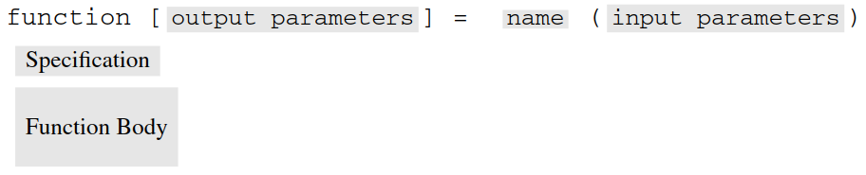
MATLAB Review
Functions: To specify a function, code of the form
has to be placed in an m-ﬁle or live function whose name is the same as the name of the function. Function names follow the same rules as variable names. Functions may have zero, one, or more input parameters and zero, one, or more output parameters.
Local Variables: Variables used by the function that are not input parameters are local, i.e., recognized only in the function’s memory space (local space). In the function MySqrt, L and W are two of the local variables.

Slide 26
MATLAB Review
Function Execution: When a function is called, the actual values are assigned to the input parameters.
Current Working Directory: A user-deﬁned function is accessible if its function ﬁle is in the Current Directory, also called the current folder. The Current Directory is indicated in a textbox near the top of the Matlab window.

Slide 27
MATLAB Review
semilogx, semilogy, loglog: Logarithmic scaling along the x-axis, y-axis, or both can be achieved by using semilogx(x,y), semilogy(x,y), or loglog(x,y). When using a logarithmic plotting function to display error, it is wise to “keep away from zero”.
Complex Numbers: MATLAB supports complex arithmetic. The statement x = sqrt(-1) assigns to x the imaginary number i which satisﬁes i² = −1. If a = real(x) and b = imag(x), then a and b are assigned the real and imaginary parts of the value in x. The arithmetic operations +, −, ∗ , and / all work when the operands are complex.

Slide 28
Questions?

Slide 29
IDS 1721
Computing and Problem Solving for STEM Chapter 05
Abstraction
Lesson 02

Slide 30
Course Learning Outcomes
Describe the fundamentals of the computing environment for problem-solving using variables, arrays, and functions.
Interpret computing concepts and distinguish between environment provided functions and user-defined functions.
Utilize programming concepts such as iteration processes, conditional statements, and logical constructs to design solutions to diverse problems.
Implement pseudo code into working code using structured programming principles.
Formulate and refine algorithms to solve problems in STEM Fields
Communicate and comment on code and solutions to multi-step problems through careful, organized, and well-annotated work.

Slide 31
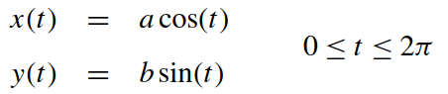
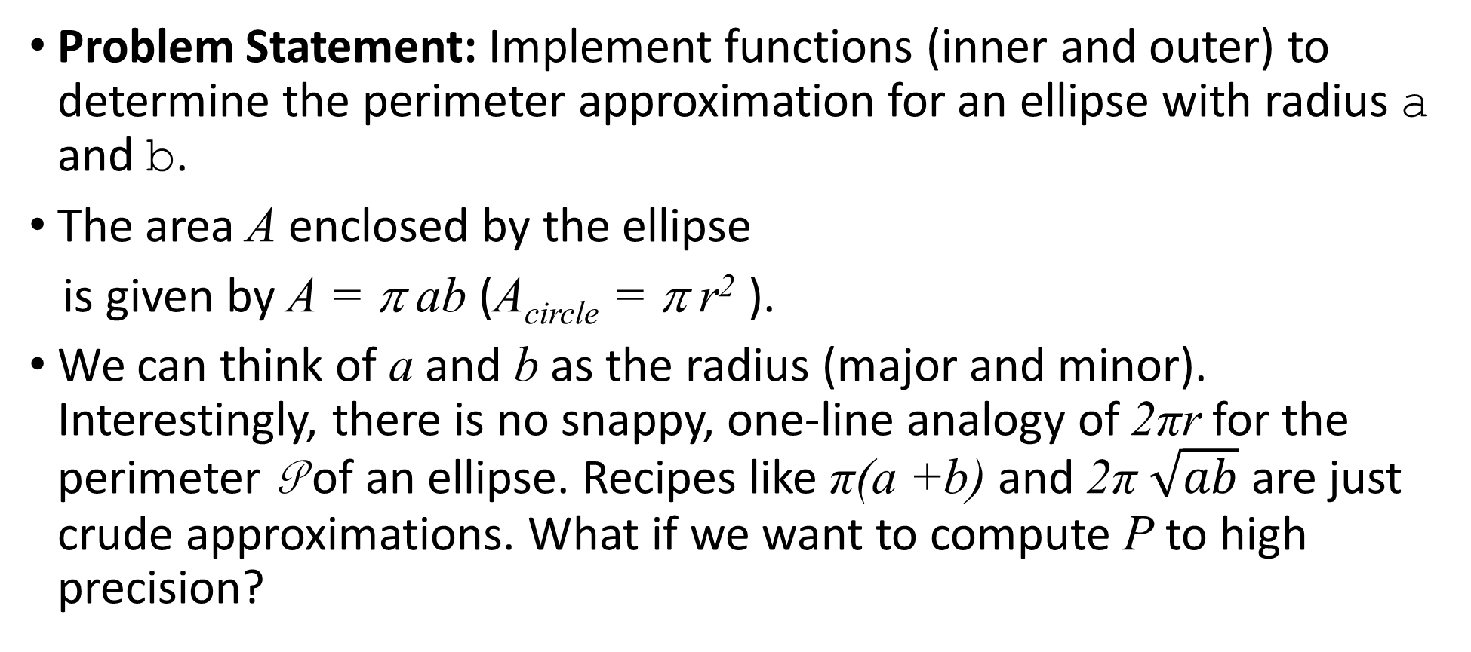
Problem Statement: Oval Odometer
Problem Statement: Implement functions (inner and outer) to determine the perimeter approximation for an ellipse with radius a and b.
The area A enclosed by the ellipse
is given by A = π ab (A_{circle} = π r² ).
We can think of a and b as the radius (major and minor). Interestingly, there is no snappy, one-line analogy of 2πr for the perimeter P of an ellipse. Recipes like π(a +b) and 2π $\sqrt{ab}$ are just crude approximations. What if we want to compute P to high precision?

Slide 32
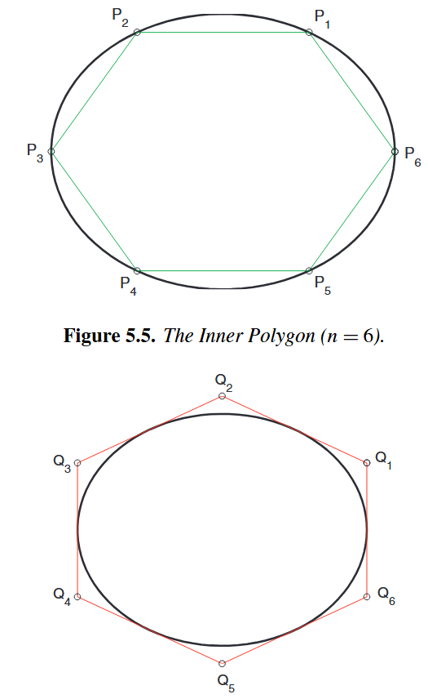
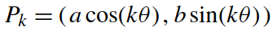
Problem Statement: Oval Odometer
One idea is to distribute n points on the ellipse and compute the perimeter of the “inner” polygon that they deﬁne. The figure illustrates the n = 6 case. For general n, the perimeter points are given by
where θ = 2π/n. If P_{inner (n)} denotes the perimeter of the inner polygon, then clearly P_{inner} (n) → P in the limit.

Slide 33
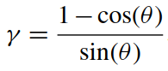
Problem Statement: Oval Odometer
An “outer” polygon approximation can be obtained by computing the perimeter of the polygon whose sides are tangent to the ellipse at P₁,...,P_{n}. The outer polygon vertices are given by
where
If P_{outer} (n) denotes the perimeter of the outer polygon, then it is obvious that P_{outer} (n) → P in the limit.

Slide 34
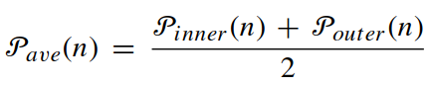
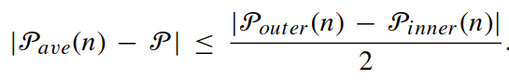
Problem Statement: Oval Odometer
Let P_{ave(n)} be the average of the two perimeters:
Since the true perimeter is in between P_{inner} (n) and P_{outer} (n), it follows that
Thus, the discrepancy between P_{inner} (n) and P_{outer} (n), is more than twice as big as the absolute error in P_{ave}(n). This fact can be used to obtain perimeter estimates of prescribed accuracy.

Slide 35
Problem Statement: Oval Odometer
Implement functions P_inner(a,b,n) and P_outer(a,b,n) that return the inner and outer perimeter approximations P_{inner} (n) and P_{outer} (n).
Implement a function P_ave(a,b,tol) that returns perimeter estimate P_{ave}(n) where n is determined so that the relative error is approximately equal to tol, a small positive tolerance.

Slide 36
Program Development
Our plan is to
(a) implement the functions P_inner and P_outer,
(b) write a script that explores their accuracy as n increases,
(c) ﬁgure out how to determine n so that the relative error in P_{ave}(n) is roughly equal to a prescribed tolerance, and
(d) implement P_ave.

Slide 37
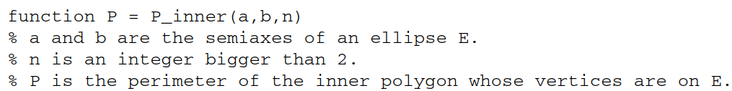
Program Development
It is a good habit to begin the task of implementing a function by writing down the function header and the speciﬁcation:
There is a “work order” advantage to doing this. The header and the speciﬁcation together spell out what we must build as implementers.

Slide 38
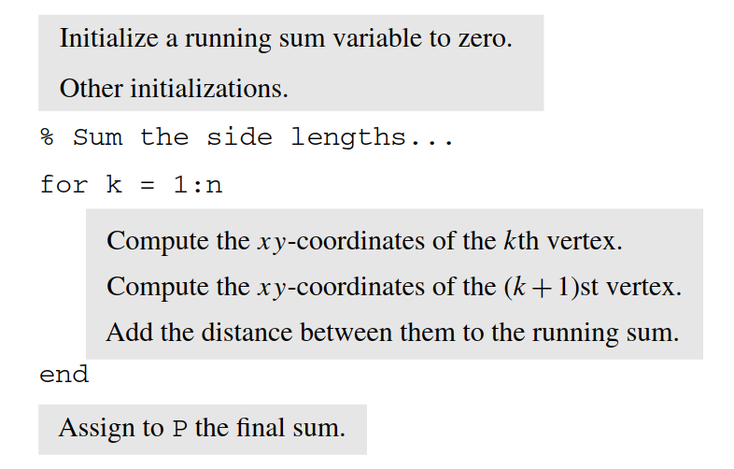
Program Development
Perimeter computation is an iterative task—we must sum the lengths of the n sides. This suggests that the implementation of P_inner revolves around a for-loop:

Slide 39
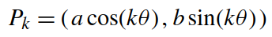
Program Development
For the running sum we use a variable innerSum. Thus, the initialization fragment must include the assignment innerSum = 0. Another calculation to perform in the initialization fragment is theta = 2*pi/n. This quantity is used over and over again in the vertex computations, so it makes sense to compute it once and for all before the loop.
The xy-coordinates of the vertices are given in

Slide 40
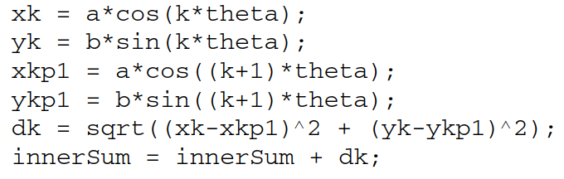
Program Development
Turning these recipes into MATLAB is straightforward and we obtain this reﬁnement of the loop body
The update of innerSum involves adding in the value of the side distance dk. In a way, we are driving around the polygon and the odometer “ticks” after we complete the journey across each side.

Slide 41
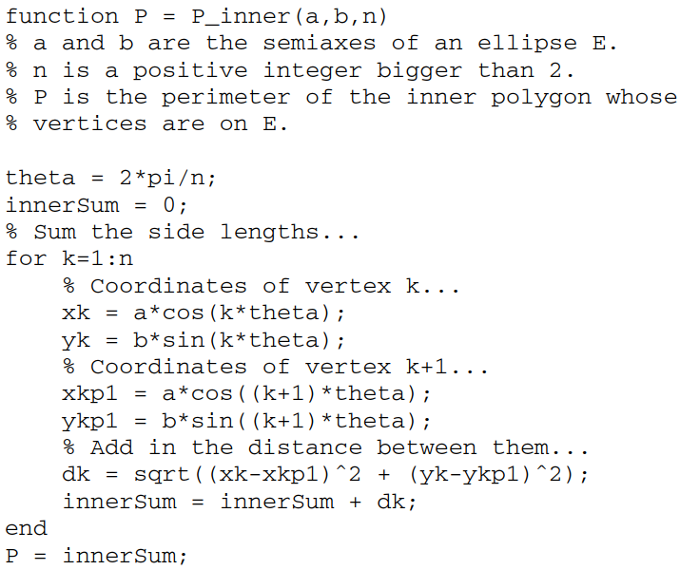
Program Development
Upon completion of the loop, innerSum houses the required perimeter value. Its value must be assigned to the output parameter P.
Thus, it becomes P = innerSum. The ﬁnal implementation of P_inner is given. The derivation of P_outer is similar.

Slide 42
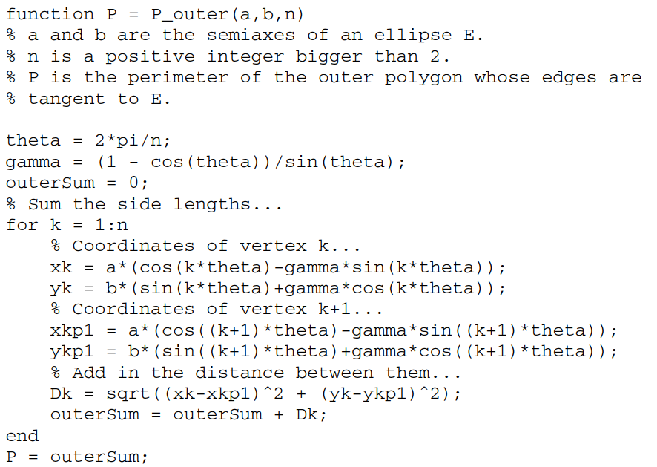
Program Development: P_outer

Slide 43
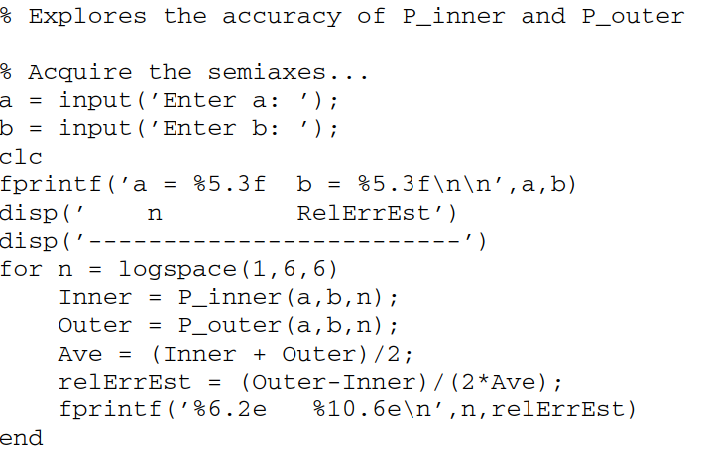
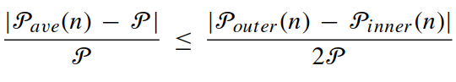
Program Development: Script
The expression for the relative error estimate relErrEstis based on the absolute error result. Since the relative error in a computed quantity is its absolute error divided by its magnitude, we see that

Slide 44
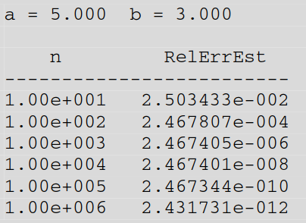
Program Development: Script
After many trials, we conclude that these results are typical.

Slide 45
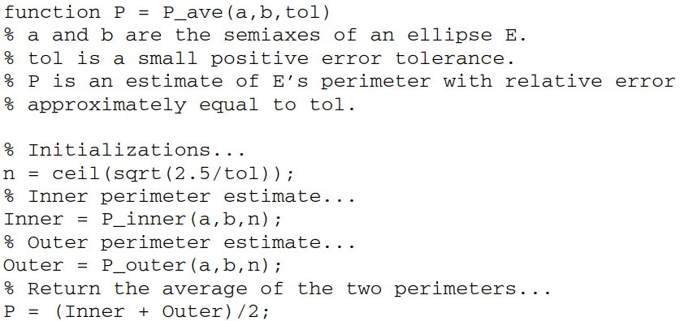
Program Development: Script
Experimentally we conclude that the relative error in P_{ave}(n). is about 2.5/n². Thus, if tol is a small positive tolerance and n = ceil(sqrt(2.5/tol)), then the relative error P_{ave}(n). is about tol. This leads to the following implementation of P_ave.
Notice that it is perfectly legal for one user-deﬁned function, e.g., P_ave, to call another
user-deﬁned function, e.g., P_inner.

Slide 46
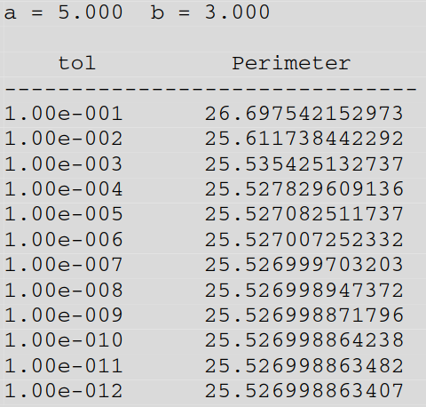
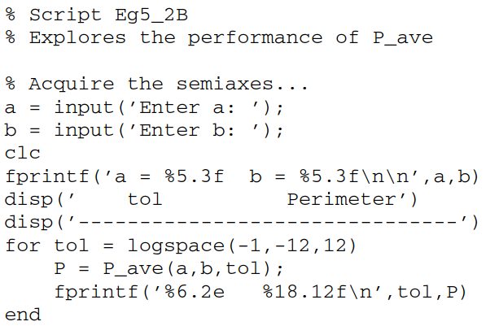
Program Development: Final Script
It reports the perimeter estimates for a range of tol values. The results suggest that the advertised level of relative error is achieved. (Recall that if a result has relative error 10^{−d} , then it will have approximately d correct signiﬁcant digits.)

Slide 47
Talking Point: Clarity, Efﬁciency, and Abstraction Level
The choice to haveP_{inner} (n), P_{outer} (n), and P_{ave}(n) in separate functions is a nice division of labor that mimics how we think about the problem mathematically.
However, scrutiny of P_inner and P_outer reveals a great deal of redundancy. To quantify this, let us pretend that each cos and sin evaluation costs one dollar and that all other calculations are free.
The way they are implemented, we conclude that the evaluations of P_inner(n) and P_outer (n) cost about 4n dollars and 8n dollars, respectively. Appreciate the wasteful extravagance. In P_inner every sine and cosine is computed twice, while in P_outer the redundancy is fourfold.

Slide 48
Talking Point: Clarity, Efﬁciency, and Abstraction Level
Noting that P_ave calls both P_inner and P_outer with the same value of n, we conclude that every cosine and sine is computed six times. Is it possible to reduce the cost of a P_ave evaluation from 12n dollars to 2n dollars?
The answer is “yes.” The idea is to change its implementation so that (a) it starts out by precomputing all the necessary cosines and sines and storing them in a pair of arrays and (b) it does not delegate to P_inner and P_outer the computation of P_{inner} (n) and P_{outer} (n)

Slide 49
MATLAB Review
Functions and Their m-ﬁles: Ordinarily, a user-deﬁned function MyFun is stored by itself in an m-ﬁle with the same name, i.e., MyFun.m. Function MyFun can call other user-deﬁned functions in the Current Working Directory or on the search path.
Search Path: The search path is a set of directories (folders) from which Matlab locates a function for execution. The search path is preset to include the directories that contain the built-in function ﬁles. You can add your own directories to the search path: in MATLAB, choose File → Set Path and click the Add Folder button.

Slide 50

MATLAB Review
Subfunctions: Ordinarily, a user-deﬁned function MyFun is stored by itself in an m-ﬁle with the same name. However, it is sometimes the case that the implementation of a particular function requires very special “helper functions” that only it needs to access. In this situation it is handy to include the helper functions in the same m-ﬁle. For example, instead of having separate m-ﬁles for P_ave, P_inner, and P_outer, we could have packaged them all in a single ﬁle as follows.
In this arrangement, P_inner and P_outer are said to be subfunctions of P_ave. A consequence of this is that these subfunctions can only be accessed by P_ave.

Slide 51
Questions?

